Slide 1

CSE101-Lec#1
Program Development in C(Development Environment/Compilation phases)
CSE101-Computer Programming

Slide 2
C Program Development Environment
C program goes through various phases such as:
Creating a program with editor
Execution of preprocessor program
Compilation
Assembly
Linking
Loading
Executing

Slide 3
Overview of phases
1. Source code is written in the text editor to generate .c extension file(also known as source code file)
2. Pre-processor works and generates Expanded Source Code file with extension (.I)
3. After this phase, compiler converts this expanded source code into assembly code and syntax errors are identified. The extension of the assembly code would be (.s)
4. This assembly code is then sent to the assembler, which converts the assembly code into object code.(.o/.obj)
5. After this phase, linker works and it combines the object file with library routines to generate the final executable file(.exe extension)
6. After this phase, loader loads the .exe file into RAM and CPU starts execution

Slide 4
Editor
Program is created in
the editor and stored
on disk.
Disk
Preprocessor
Disk
Preprocessor program
processes the code.
Compiler Assembler
Compiler compiles the code and creates assembly code and further assembler creates object code and stores
it on disk.
Disk
Linker
Disk
Linker links the object
code with the libraries,
Primary Memory
Loader
Loader puts program in memory.
Disk
.
.
.
.
.
.
Primary Memory
CPU
CPU takes each
instruction and
executes it, possibly
storing new data
values as the program
executes.
.
.
.
.
.
.

Slide 5
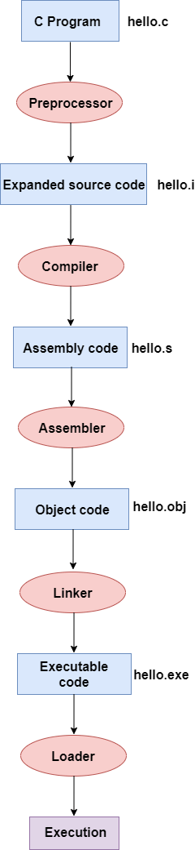
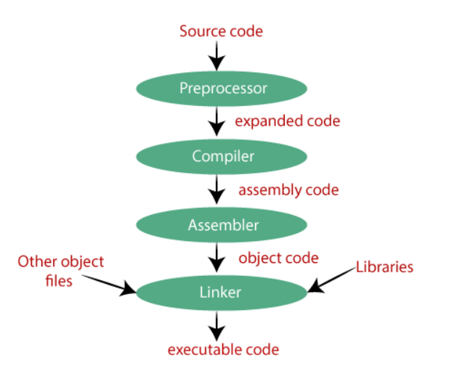

Slide 6
Key points
Preprocessing:
Generates expanded source code
Removal of comments
Expansion of included files(e.g. Header files)
Compilation:
Detects syntax errors
Preprocessed code is translated to assembly instructions specific to the target processor architecture.
The existence of this step allows for C code to contain inline assembly instructions and for different assemblers to be used.

Slide 7
Key points
Assembly:
This stage is used to translate the assembly instructions to object code
The output consists of actual instructions to be run by the target processor.
Linking:
The result of this stage is the final executable program.
Mainly, all the programs written in C use library functions. These library functions are pre-compiled, and the object code of these library files is stored with '.lib' (or '.a') extension. The main working of the linker is to combine the object code of library files with the object code of our program.
Sometimes the situation arises when our program refers to the functions defined in other files; then linker plays a very important role in this. It links the object code of these files to our program.
So, it links the object code of our program with the object code of the library files and other files.

Slide 8
Polling Questions
Which of the following component will point out the syntax errors in the code?
A. Linker
B. Compiler
C. Loader
D. Preprocessor
Notes:
Ans:B

Slide 9
Extension of expanded source code file is
A. (.obj)
B. (.i)
C. (.s)
D. (.exe)
Notes:
Answer:B

Slide 10
Which of the following component generates the final .exe file?
A. Linker
B. Loader
C. Assembler
D. Compiler
Notes:
Answer:A

Slide 11
Role of preprocessor is to:
A. Detect syntax errors
B. Generate object code
C. Combine various object files and library files together
D. Include the code of header files at the point, where they are included to generate expanded source code
Notes:
Answer: D

Slide 12
Which of the following extension is valid for a file containing assembly code?
A. (.obj)
B. (.i)
C. (.s)
D. (.exe)
Notes:
Answer:C

